Slide 1

Apigee Flows and Policies
Ashish Pathak

Slide 2
Introduction
API Proxy
Flows
Proxy Pre/Post flows
Target Pre/Post flows
Client Response Flow
Policies
Quota
Spike
Assign Message
Raise Fault
OAuth Verification
Fault Handling
Apps and Products

Slide 3
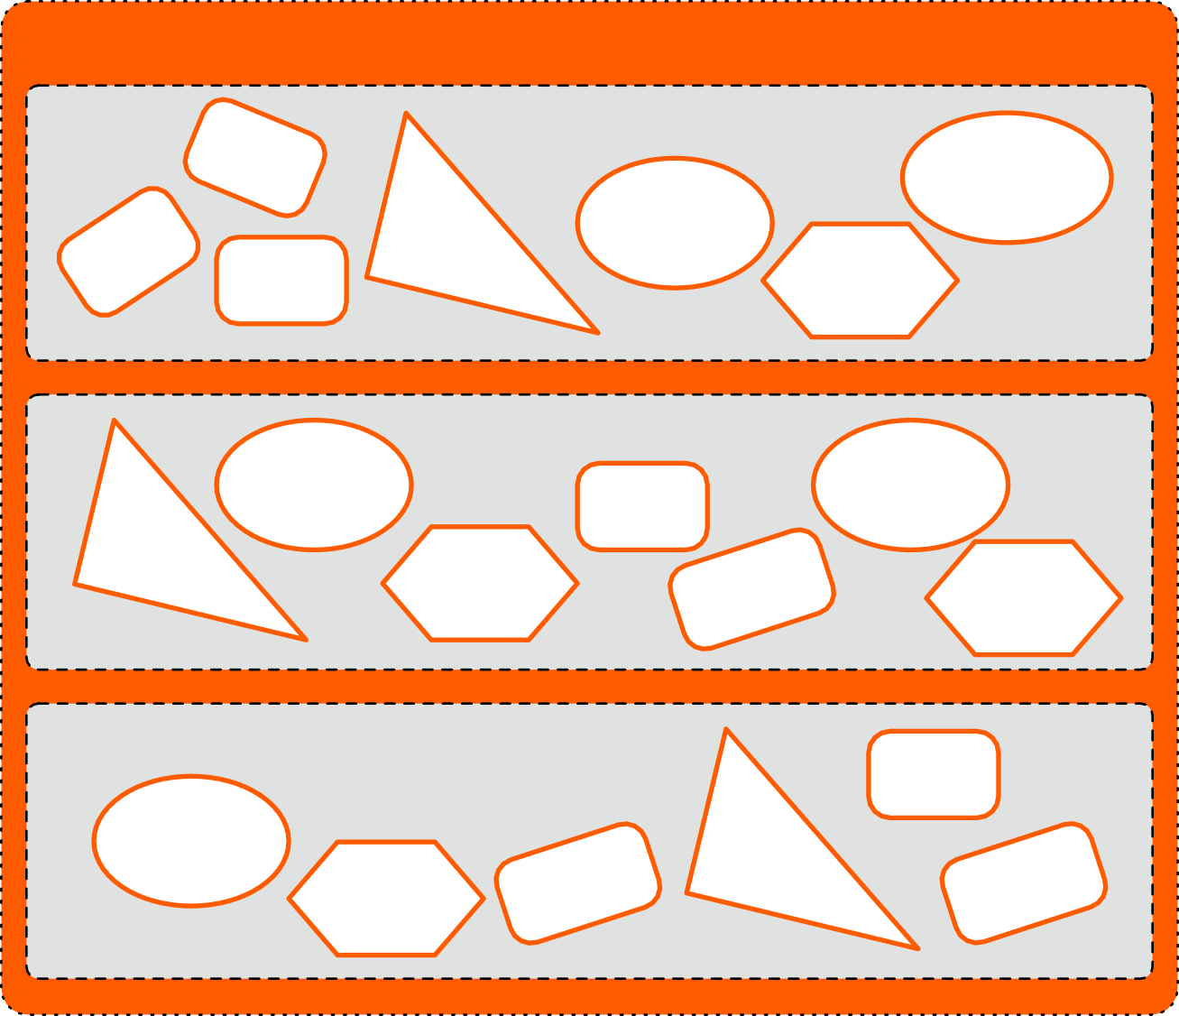
API Proxies
API Proxy
Proxy Endpoints
Policies
Fault Rules
Flows
Preflow
VH
Routes
Postflow
Target Endpoints
Preflow
Target Server
Policies
Flows
Load Balancers
Postflow
Fault Rules
Resources
XSL
Java
Nodejs
Javascript
Python
WSDL

Slide 4
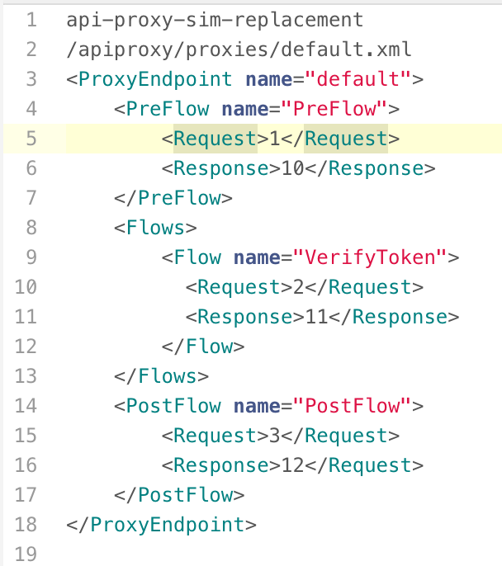
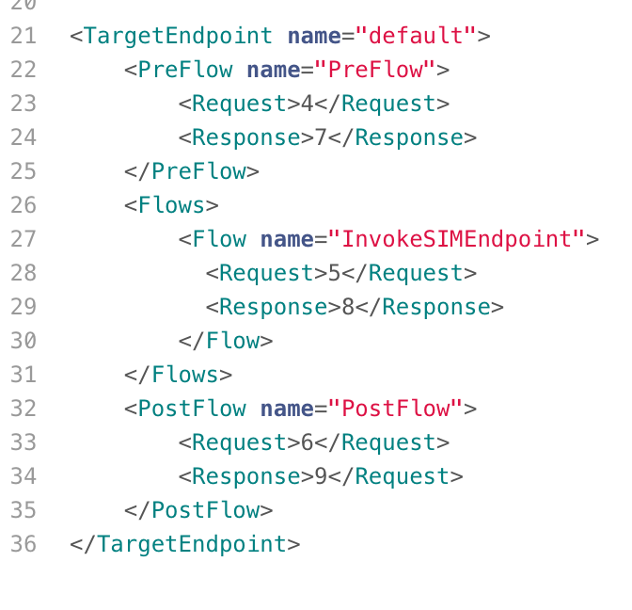
Policy Flows

Slide 5
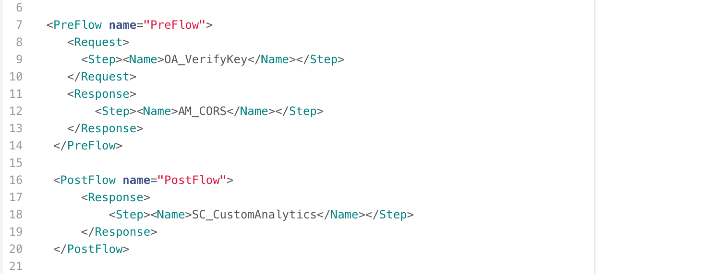
Policy Flows
Global Flow

Slide 6
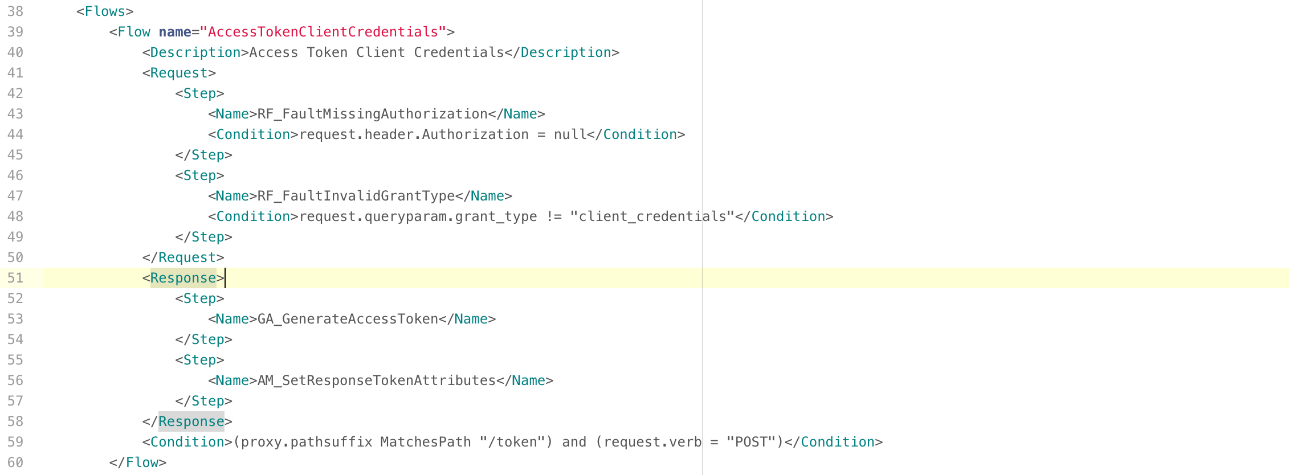
Policy Flows
Conditional Flow

Slide 7

Quota
Use the Quota policy to configure the number of request messages that an API proxy allows over a period of time, such as a minute, hour, day, week, or month.
Quota/Rate Limit which is business requirement. Don't use Quota to shield against overall traffic spikes.
Once a quota limit is reached all request generated by the limited entity will be rejected

Slide 8
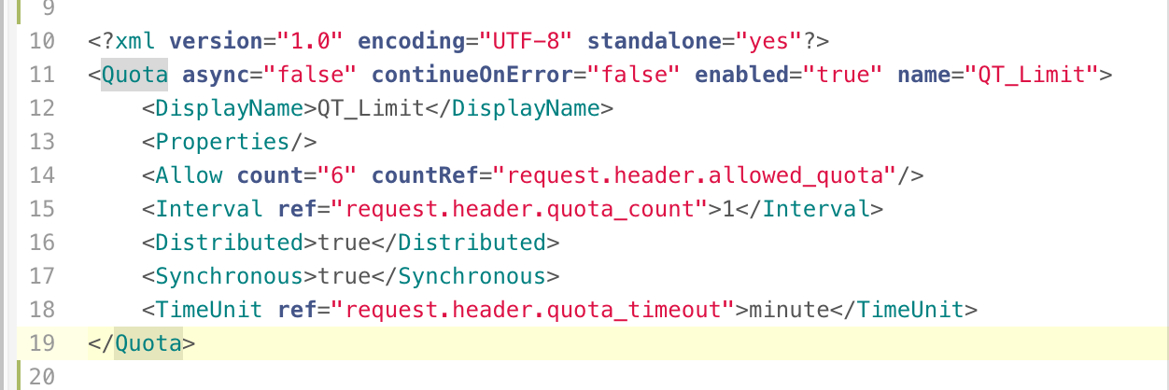
Quota Config
Identifier: Mechanism to scope incoming request
Uses a separate rate for each unique Id
Message Weight
Used to give extra weight to conditioned requests

Slide 9




















Spike Arrest
Smooth’s the inflow of request pattern over short intervals to ensure demand doesn’t outstrip the supply.
Spike Arrest is technical requirement to protect backend as opposed to Quota/Rate Limit which is business requirement.
Often used to offset DOS/DDOS attacks
gateway.optus.com.au
apps
2,000 tps
1,000 tps

Slide 10
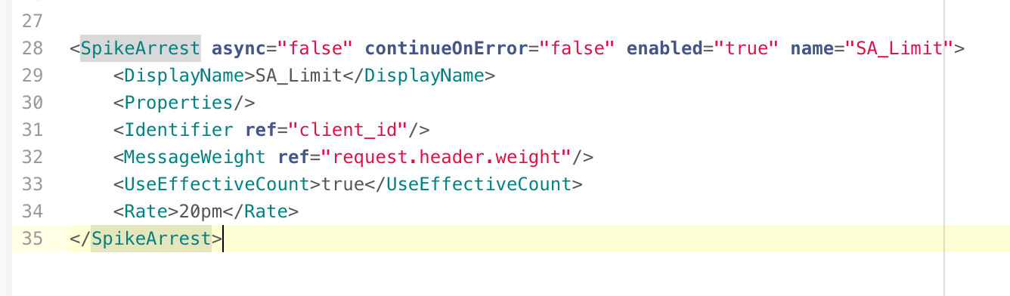
Spike Arrest Config
Identifier
Mechanism to scope incoming request
Uses a separate rate for each unique Id
Message Weight
Used to give extra weight to conditioned requests
Rate
Specifies the rate you want to allow traffic to come into your API
Rate is for each Message Processor
Rate is formatted with number and unit (30ps/ 60pm)

Slide 11
Demo
Quota
Spike Arrest

Slide 12
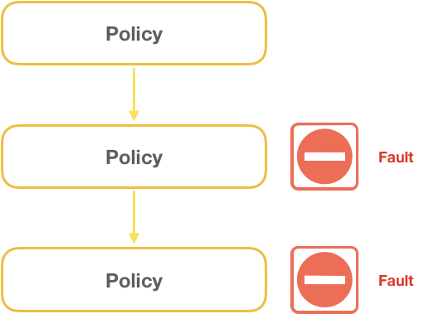
Fault Handling
Errors occur while processing policies.
Handling of faults and returning custom error messages to client.

Slide 13
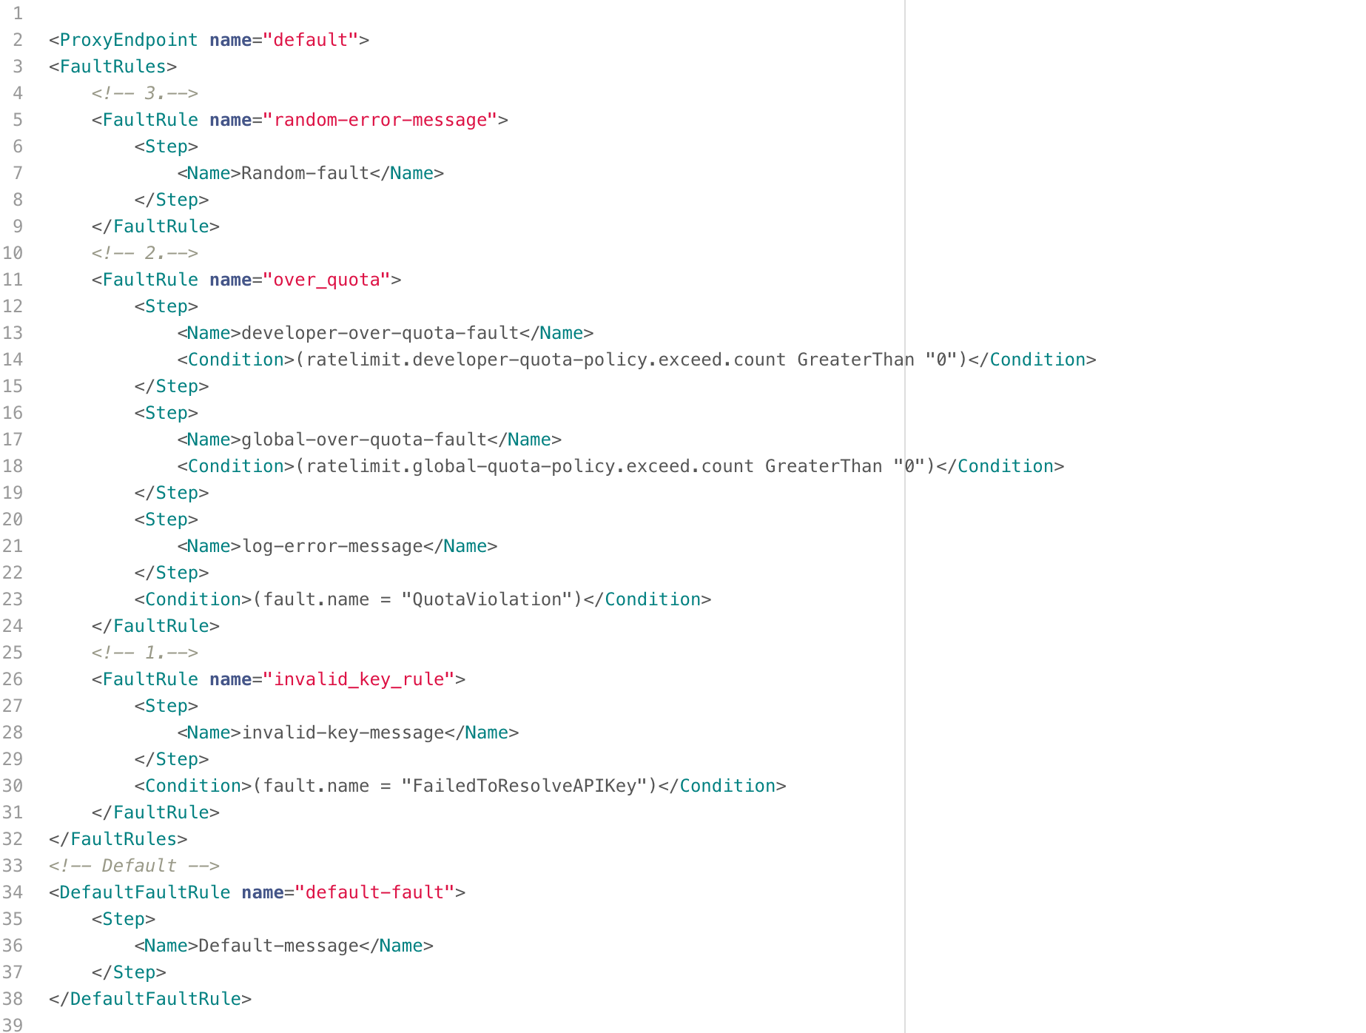
Fault Handling Config

Slide 14
Demo
Fault Handling

Slide 15
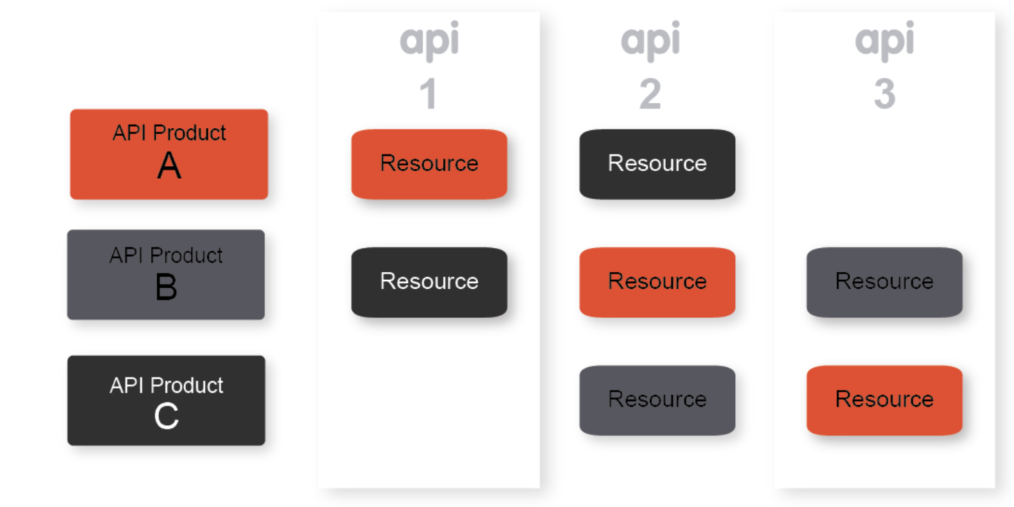
Products And Proxies
Products can have multiple Proxies (many to many)
App can have multiple products (many to many)
Product strategies depend of different models

Slide 16

Securing APIs
Verify API Key
OAuth v2.0
Verify JWT
Verify JWS
Generate JWT
Generate JWS
Validate SAML Assertion
Generate SAML Assertion

Slide 17
Demo
Verify API Key
OAuth (client credentials)

Slide 18
Thanks
Our squad enables the Service Hub to release quicker and better, driving costs down and improving quality.

